Slide 1
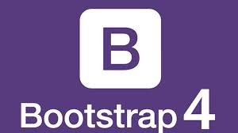


Slide 2

What is Bootstrap
Bootstrap is a free front-end framework for faster and easier web development
Bootstrap includes HTML and CSS based design templates for typography, forms, buttons, tables, navigation, image carousels and many other, as well as optional JavaScript plugins
Bootstrap also gives you the ability to easily create responsive designs

Slide 3
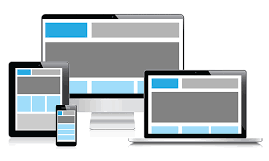
What is Responsive Web Design?
Responsive Web Design makes your web page look good on all devices (desktops, tablets, and phones).

Slide 4
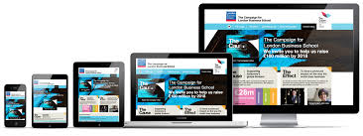
Why Bootstrap... ?
Faster Devolopment.
Browser Support.
Number of devices Support.
Essy to use.
Free.

Slide 5
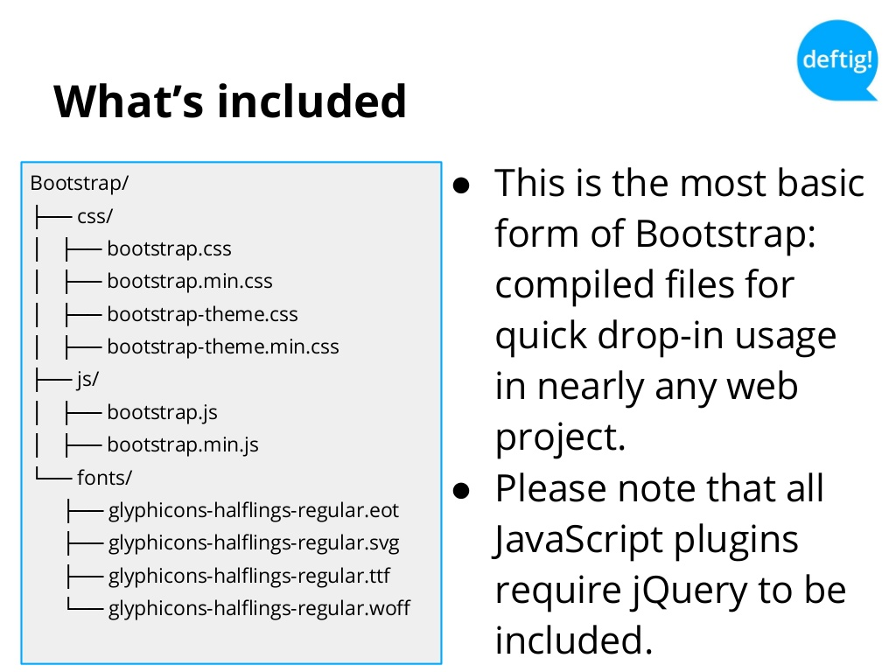
What is included

Slide 6
Layout
Containers
<div class="container">
<!-- Content here -->
</div>
<div class="container-fluid">
...
</div>

Slide 7
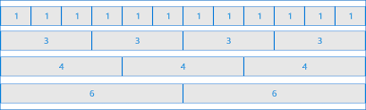
Layout
Grid system
Bootstrap's grid system is built with flexbox and
allows up to 12 columns across the page.

Slide 8
Grid Classes
The Bootstrap 4 grid system has five classes:
.col- (extra small devices - screen width less than 576px)
.col-sm- (small devices - screen width equal to or greater than 576px)
.col-md- (medium devices - screen width equal to or greater than 768px)
.col-lg- (large devices - screen width equal to or greater than 992px)
.col-xl- (xlarge devices - screen width equal to or greater than 1200px)

Slide 9
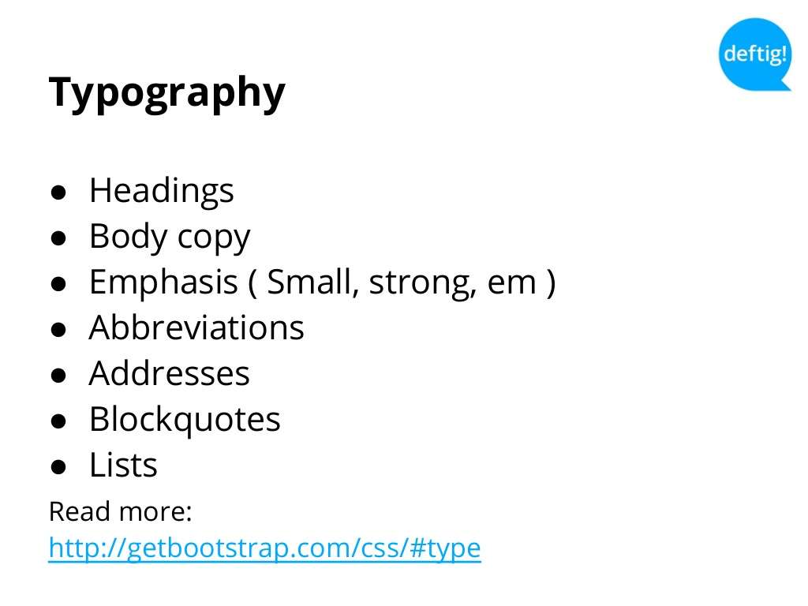
Typography

Slide 10
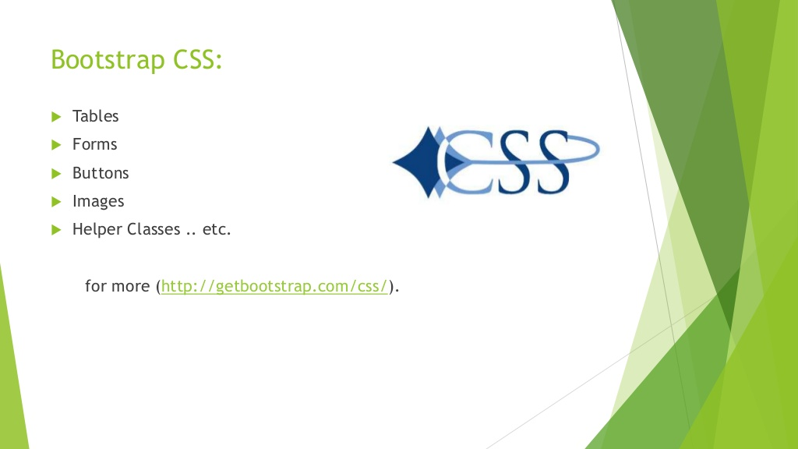
CSS

Slide 11
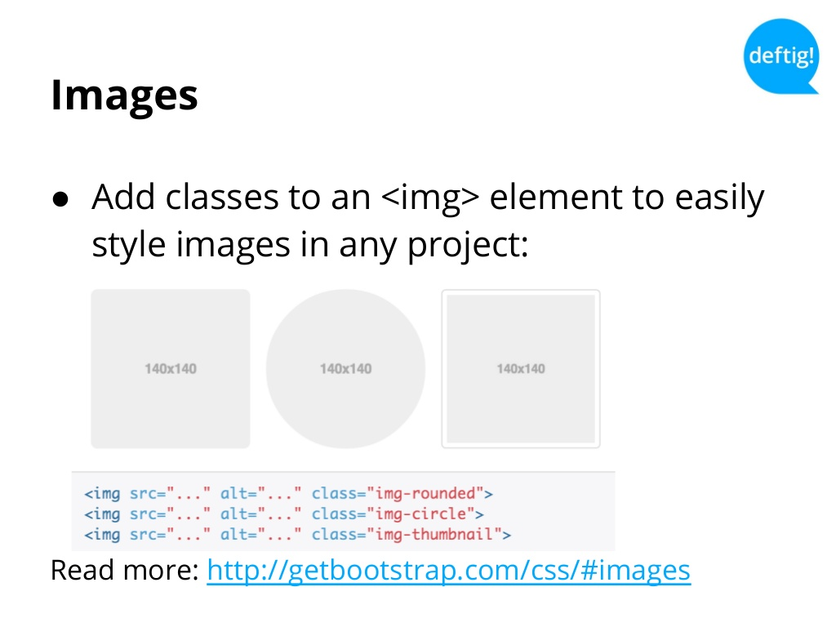
Images

Slide 12
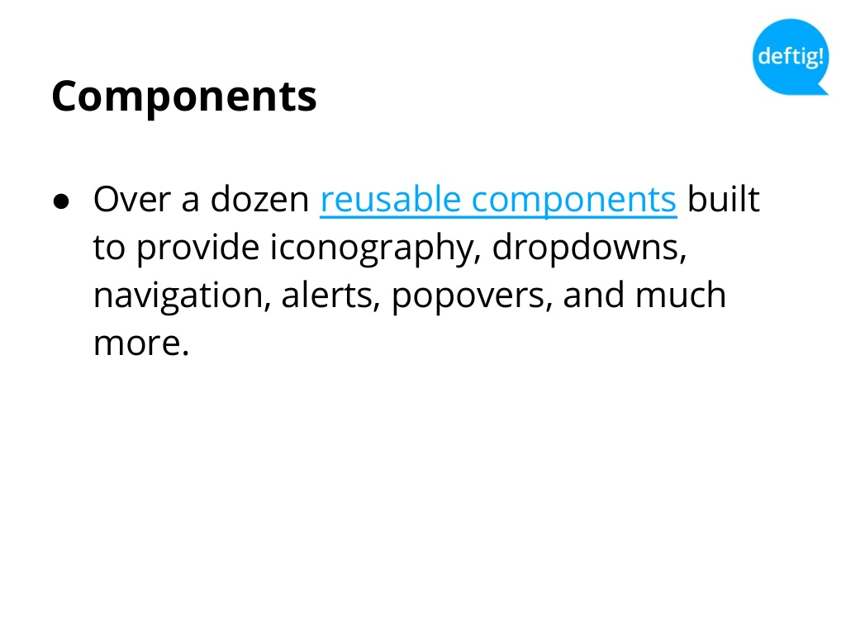
Components

Slide 13
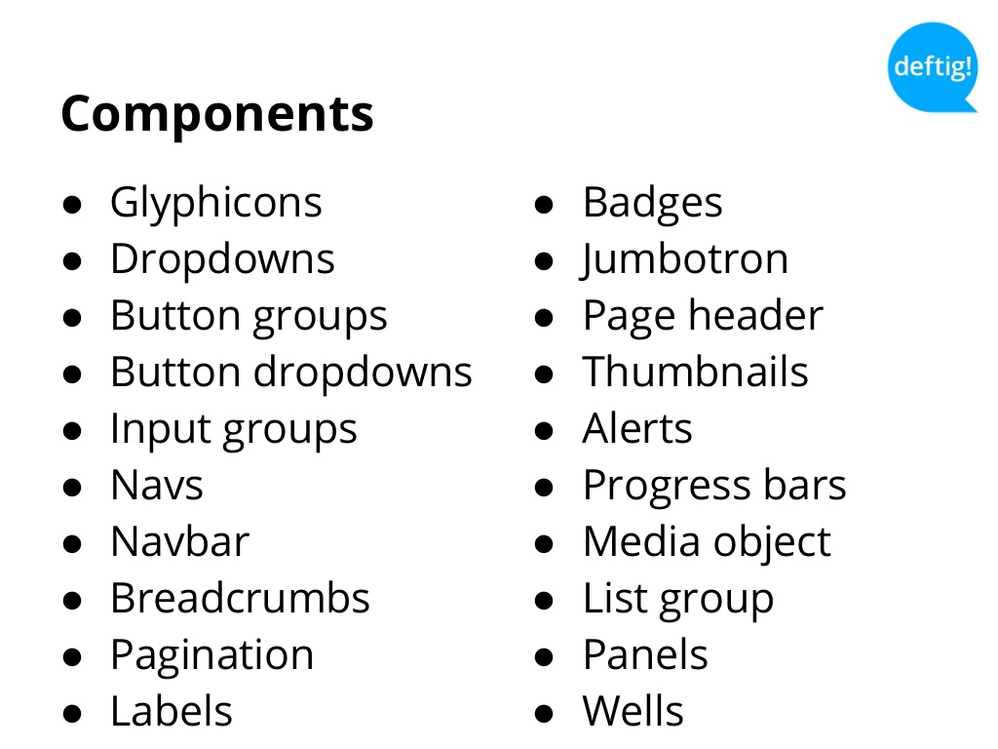
Components

Slide 14
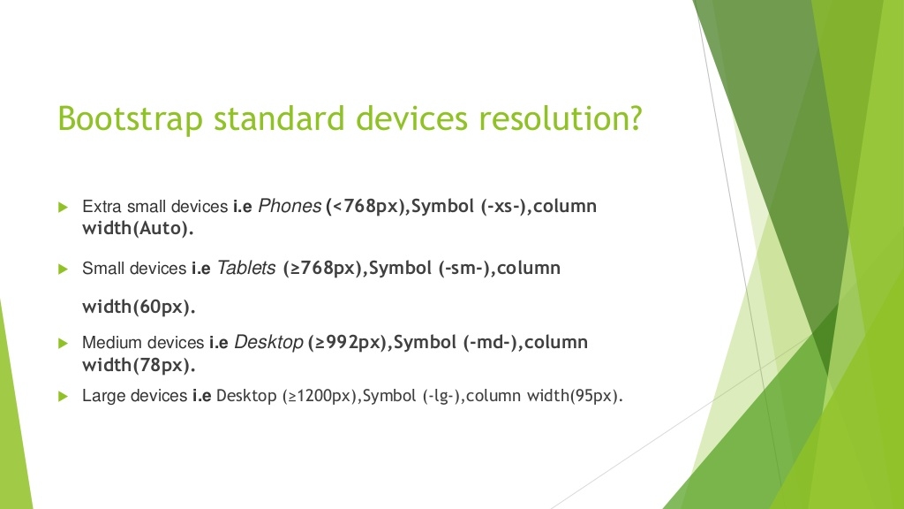
Bootstrap

